Slide 1
Segmenting and Clustering Socio-Economic Activities in Kenyan Counties (Sammy Ongaya)

Slide 2
Business Statement
Each County government is obligated to generate its own revenue and supplement the income disbursed from the national government. Therefore the each Counties stakeholders and administrator sought to analyse the most viable economical activities that will increase revenue and improve the livelihood of its people.
Also for any organization and stakeholders wishing to expand their business operation to different Counties will need to understand the best County to invest in.
With this analysis the stakeholders are well informed on the most appropriate economical activities to invest in each county and make informed decision that will yield high ROI.

Slide 3
Data
We use data from 47 Counties in Kenya. The data is extracted from the wikipedia website through web scrapping using Python based library.
The data has County name, Area in KM squared and Population Census as of 2009 among other details. We use the geopy library to get the coordinates of each county. We then create a map of Kenya and plot the coordinates of each county using the folium library.
We use the Foursquare API to extract relevant information such as facilities within a radius of 25km for all Counties and get the venue categories for each facility.

Slide 4
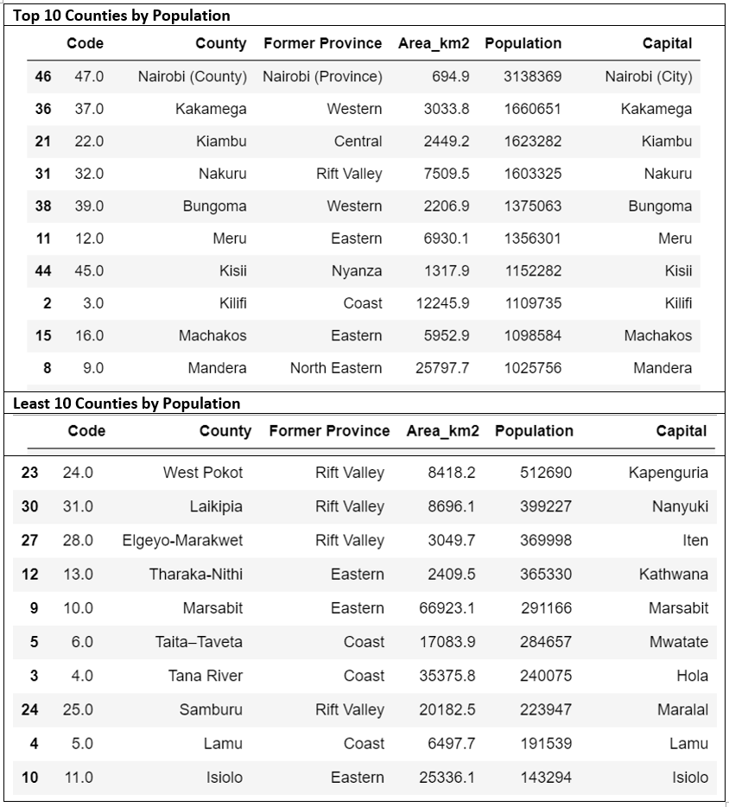
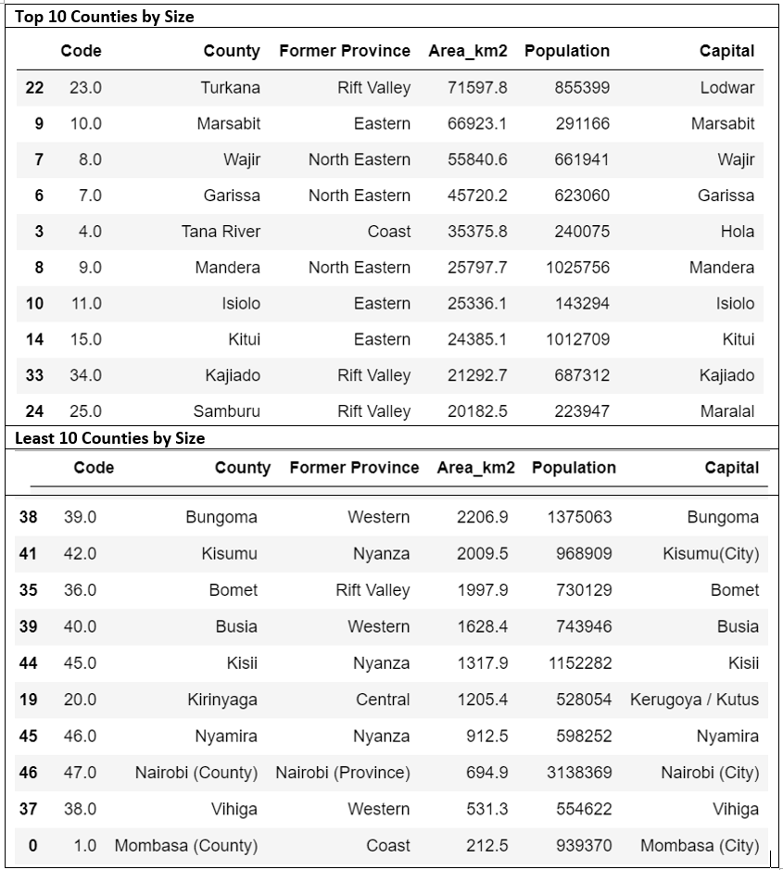
Distribution of Counties by Population and Area

Slide 5
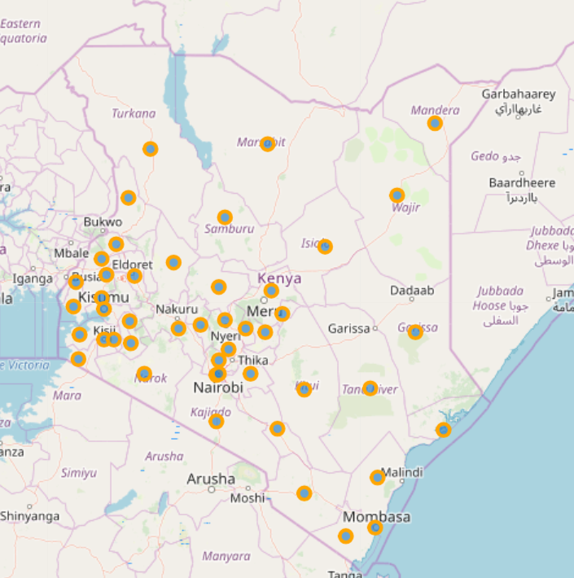
Kenya Counties

Slide 6
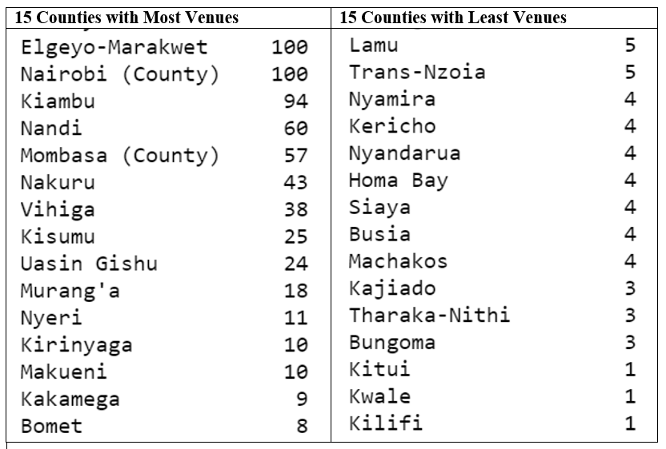
Counties and Venues

Slide 7
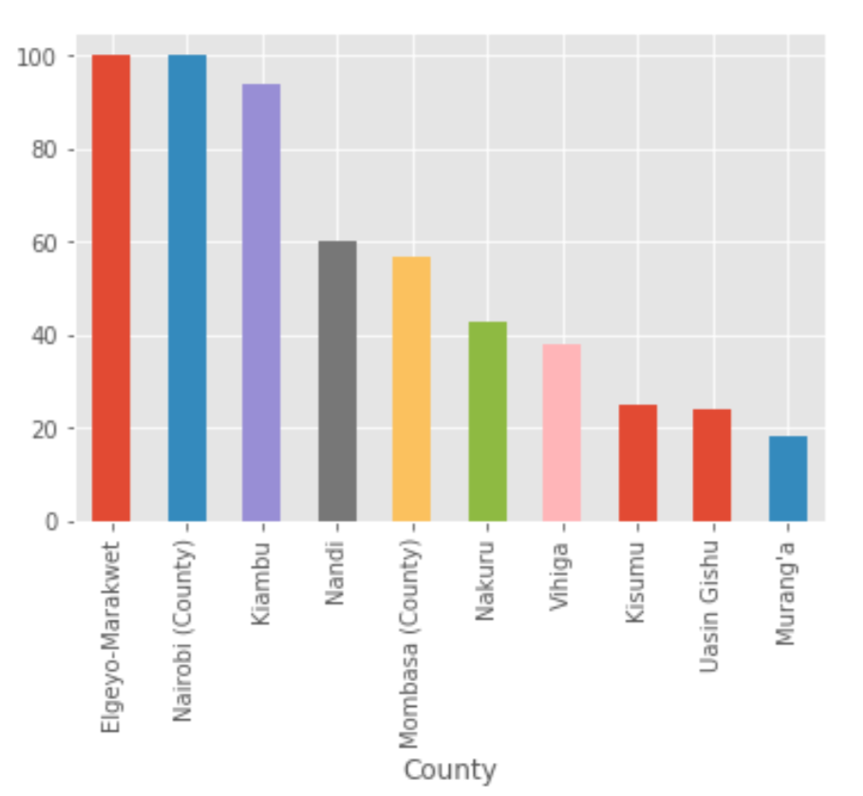
Counties and Venues

Slide 8
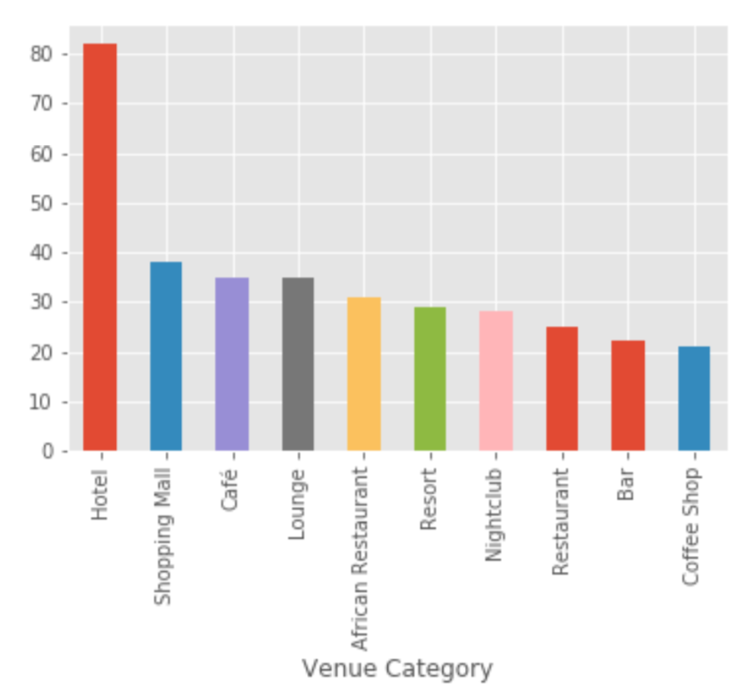
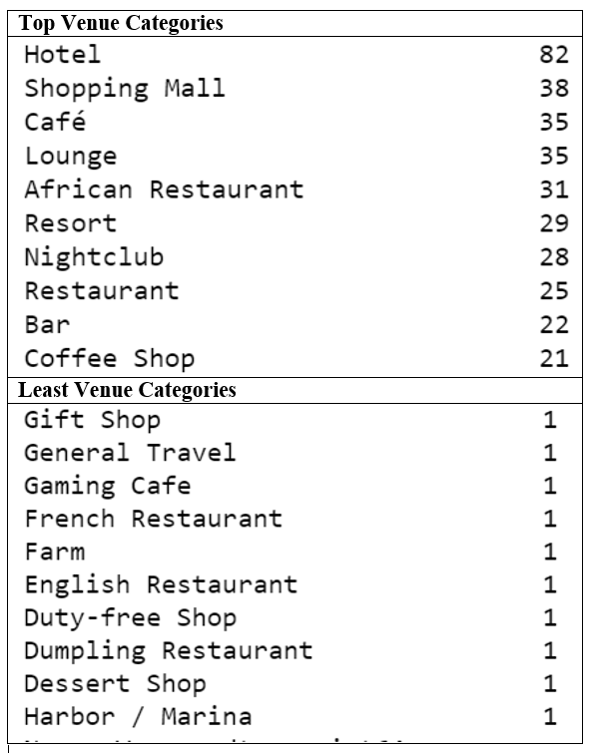
Venue Categories

Slide 9
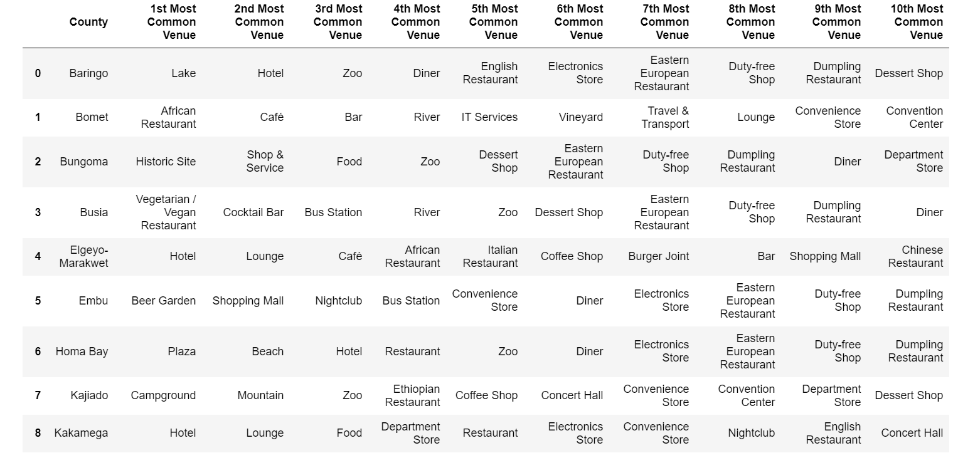
10 most common venues in each County

Slide 10
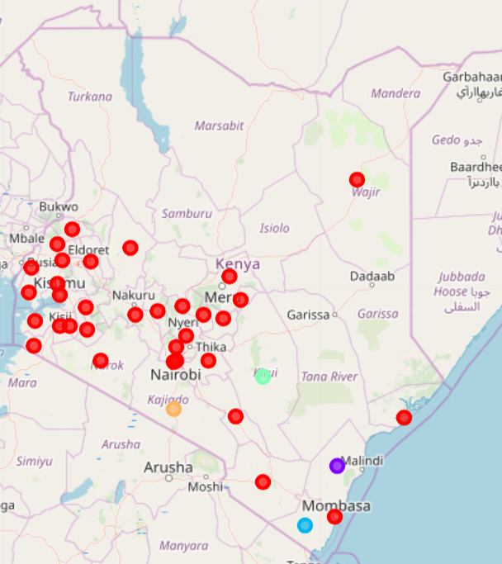
Our Clustering Algorithm
We have 5 clusters represented by colors red for cluster 1, blue for cluster 2, orange for cluster 3, green for cluster 4 and purple for cluster 5.
Most data points fall under cluster 1 which comprises of food courts, hotels, resorts and restaurants.
Some Counties such as Turkana, Marsabit, mandera and Samburu don’t have venue data.

Slide 11
Conclusion
This analysis provides valuable insights for investors who wants to start business in Kenya in different Counties.
This analysis is limited to the data collected from the foursquare API which is not sufficient.
The analysis can be improved further by collecting more data.

